Slide 1
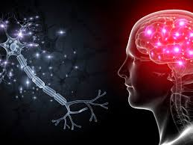
Medical physics first year
L26-Electricity within the body
The Nervous System and the Neuron.
By Assistants professor
Dr.Mohammed Ali Jaber
Physiology Department
College of Medicine
University of Basrah

Slide 2
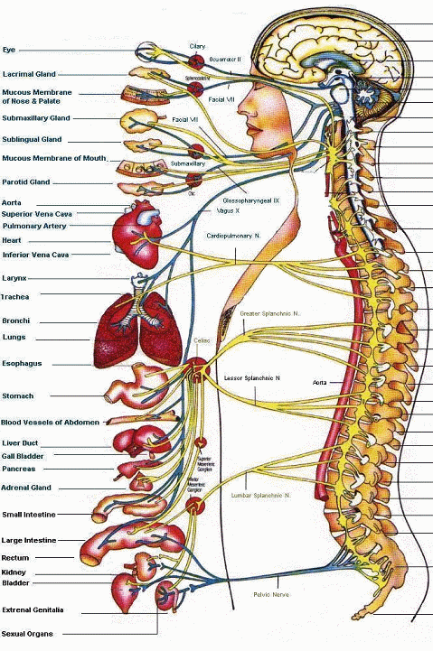
The nervous system and the neurons
The nervous system can be divided in two parts:
1-Central nervous system consists of the
Brain
Spinal cord
Nerve fibers (neurons)
Transmits sensory information to brain or spinal cord and from brain or spinal cord to appropriate muscles and glands.
2. Autonomic nervous system
Controls various internal organs such as the heart, intestines, and glands
/25

Slide 3
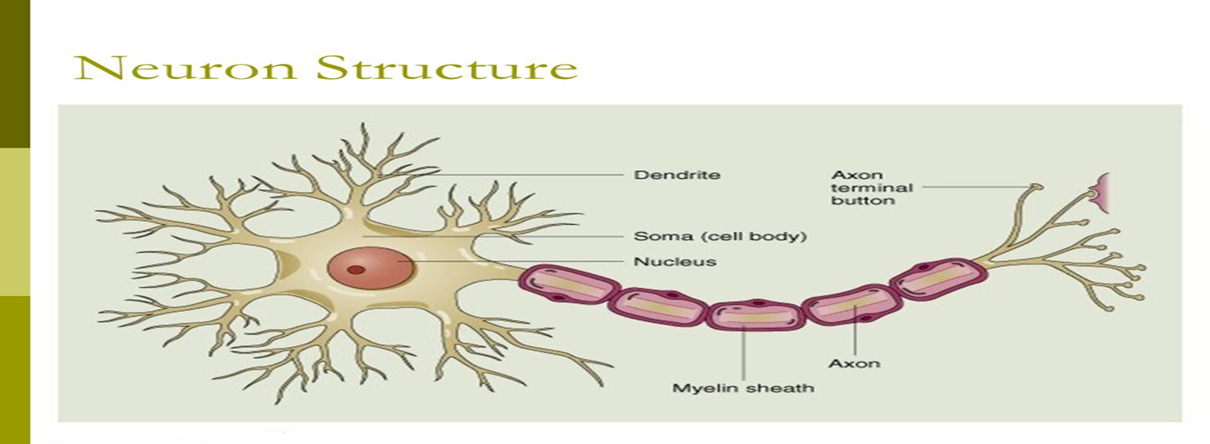
The motor neuron : a nerve cell specialized for the reception , interpretation , and transmission of electrical messages.
A motor neuron: is a nerve cell (neuron) consists of :
Cell body is located in the spinal cord and
Fiber (axon) projects outside the spinal cord to directly or indirectly control effector organs.
/25

Slide 4
How does the human body generate electricity?
It is because chemical reactions between different atoms and molecules within the body.
The electricity generated inside the body severs for the
control and operation of
nerves
muscles
organs
/25

Slide 5
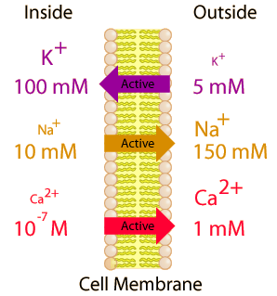
Electrical potentials of nerves
The neuron is said to be polarized.
The inside of the cell is typically 60-90 mv more negative than outside.
/25

Slide 6
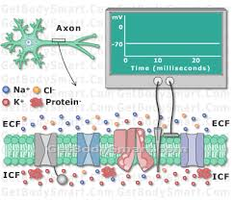
Resting Potential :
The inside of the cell is 60-90 mV more negative than the outside. This potential difference is called the resting potential of the neuron.
/25

Slide 7
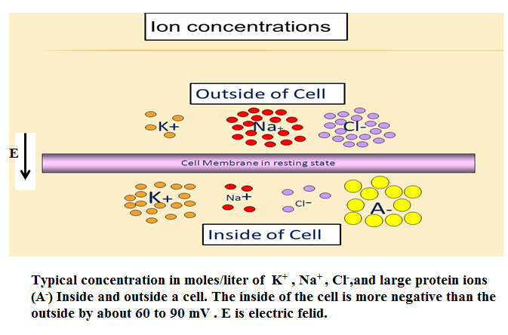
The typical concentrations of various ions inside and outside the membrane of an axon.
/25

Slide 8
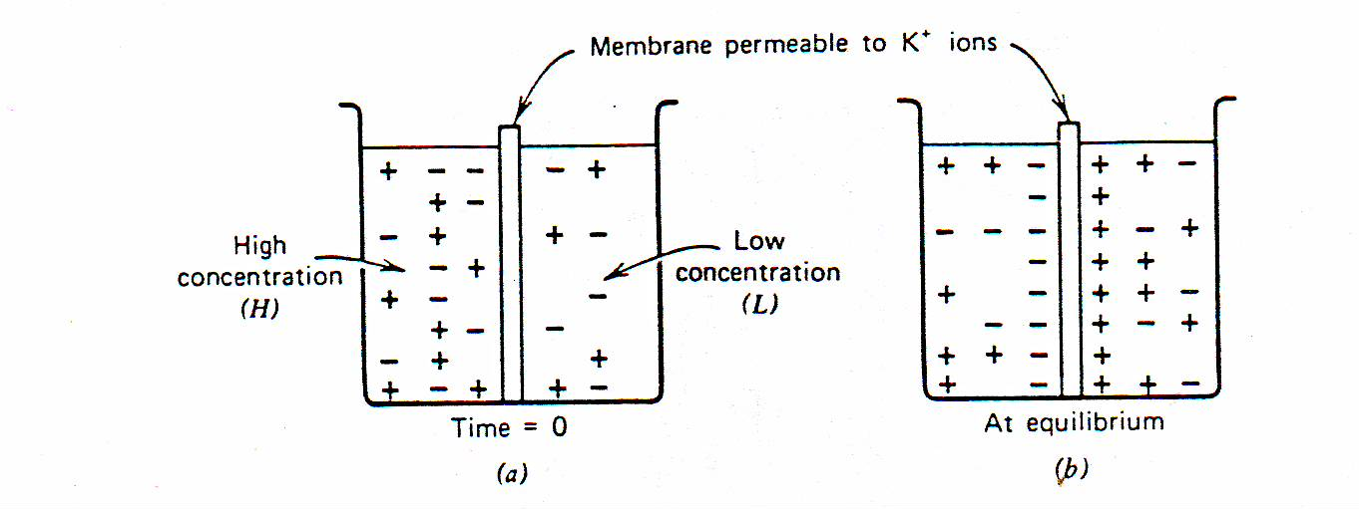
/25

Slide 9
The resting membrane potential of a neuron is about( -70) mV (mV=millivolt) - this means that the inside of the neuron is 70 mV less than the outside.
At rest, there are relatively more sodium ions outside the neuron and more potassium ions inside that neuron.
/25

Slide 10
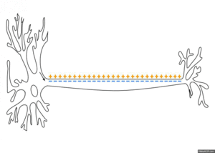
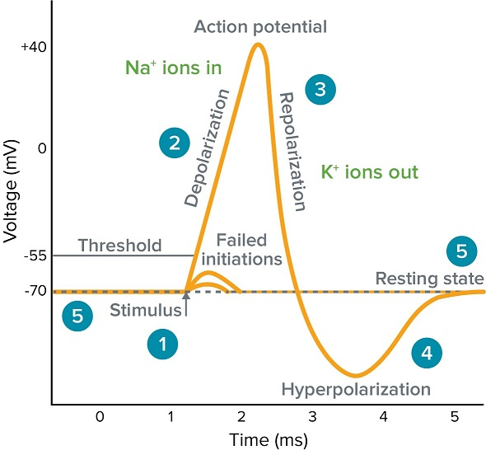
Action Potential: When the neuron is stimulated ,
a large momentary change in the resting potential occurs at the point of stimulation.
This potential change ,is called the action potential. Propagates along the axon.
/25

Slide 11
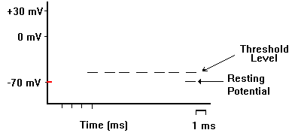
P Na⁺ P K⁺
P Na⁺
/25

Slide 12
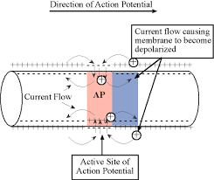
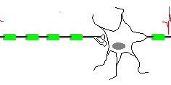
An action potential is caused by positive ions moving in and then out of the neuron at a certain spot on the neuron membrane.
/25

Slide 13
Depolarization
Repolarization
/25

Slide 14
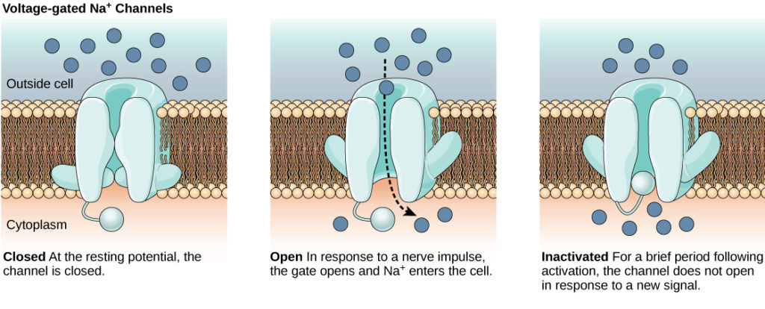
Refractory Period
Harder for the axon to produce subsequent action potentials during this interval
During this time (~ 1 msec), the Na+ and K+ Channels cannot be opened by a stimulus.
The Na+/K+ Pump actively pumps Na+ out of the neuron and K+ into the neuron.
This reestablishes the initial ion distribution of the resting neuron.
/25

Slide 15
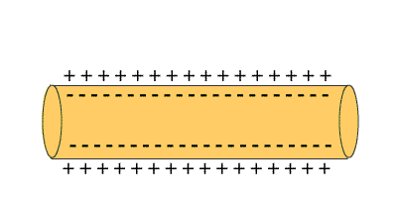
This single action potential acts as a stimulus to neighboring proteins and initiates an action potential in another part of the neuron.
The wave of action potentials travel from the dendrites all the way to the axon terminals.
At the axon terminal, the electrical impulse is converted to a chemical signal.
/25

Slide 16
The factors effect the speed of propagation of action potential
The decrease in either will increase the propagation velocity
The resistance within the core of the membrane.
The internal resistance of an axon decreases as the diameter increases (large diameter → higher velocity ).
2-The capacitance across the membrane (charge stored )
The greater the stored charge on a membrane → the longer it takes to depolarize it , and thus the slower the propagation speed
/25

Slide 17
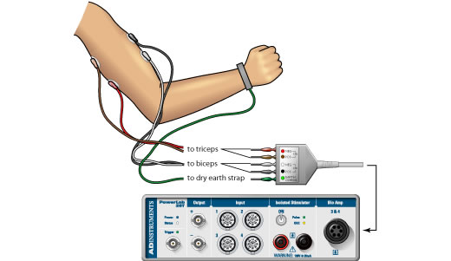
Electrical Signals From Muscles –
the ELECTROMYOGRAM EMG
Electromyography (EMG)
Is an electro diagnostic medicine technique for evaluating and recording the electrical activity produced by skeletal muscles
EMG is performed using an instrument called an electromyography, to produce a record called an electromyogram
An electromyography detects the electrical potential generated by muscle cells when these cells are electrically or neurologically activated.
/25

Slide 18
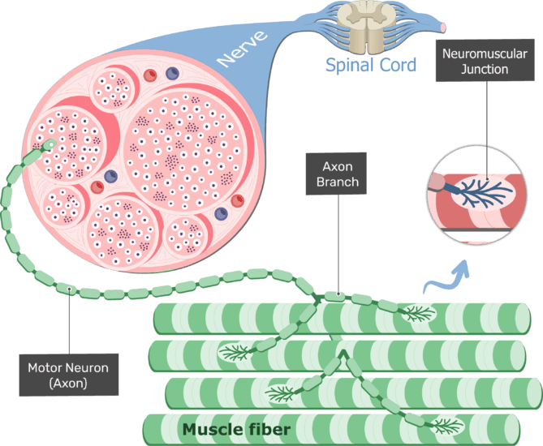
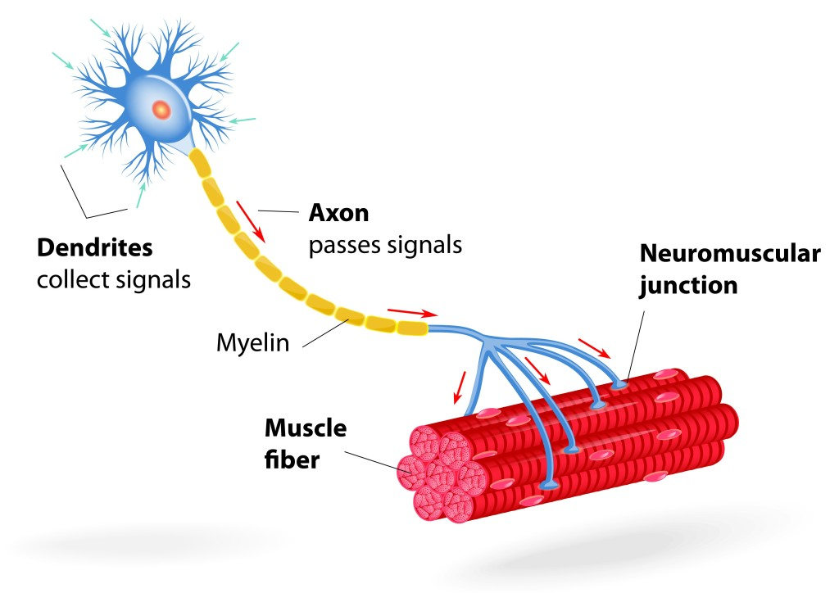
A muscle is made up of many motor units .
/25

Slide 19
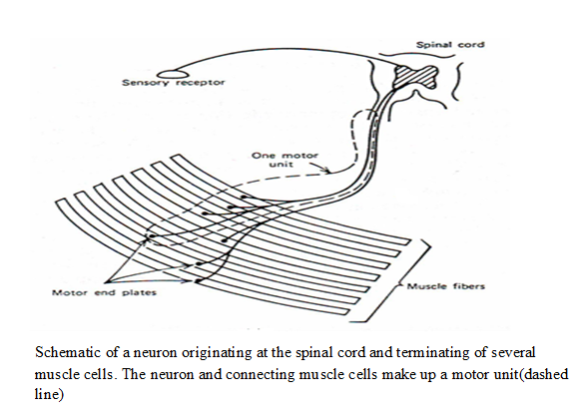
/25

Slide 20
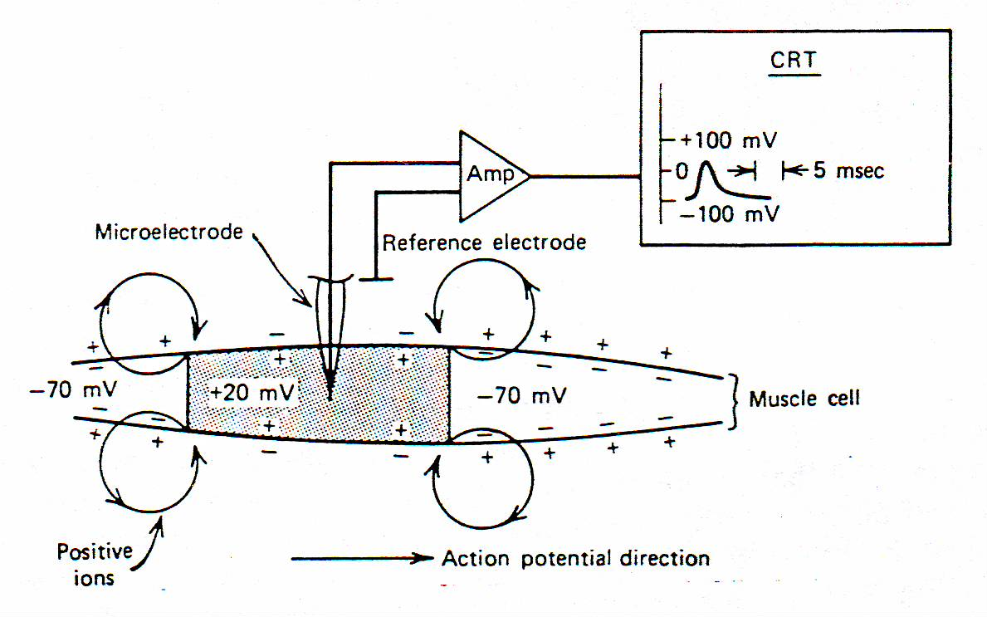
Muscle action is initiated by an action potential that travels along an axon and is transmitted across the motor end plates into the muscle fibers, causing them to contract.
/25

Slide 21
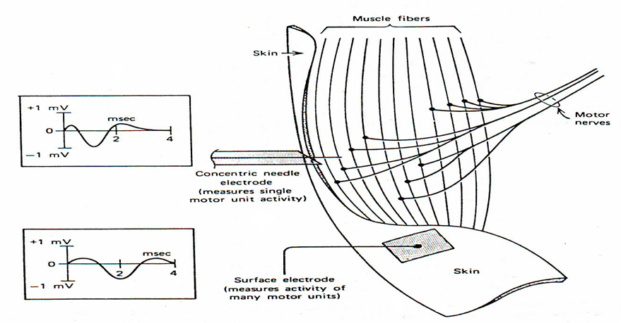
EMG electrodes usually record the electrical activity from several fibers. Either a surface electrode or a concentric needle electrode inserted under the skin is used .
/25

Slide 22
Nerve Conduction Velocity Calculation
It is the speed at which an electrochemical impulse propagates down a neural pathway.
Conduction velocities are affected by a wide array of factors, including:
Age , sex, and various medical conditions.
/25

Slide 23
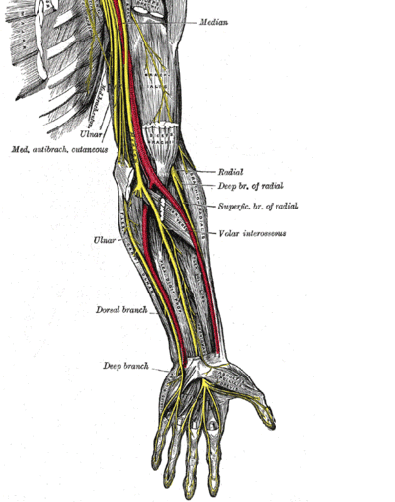
Nerve Conduction Velocity Calculation
The time difference between stimulation from the first electrode and pick-up by the downstream electrode is known as the latency.
/25

Slide 24
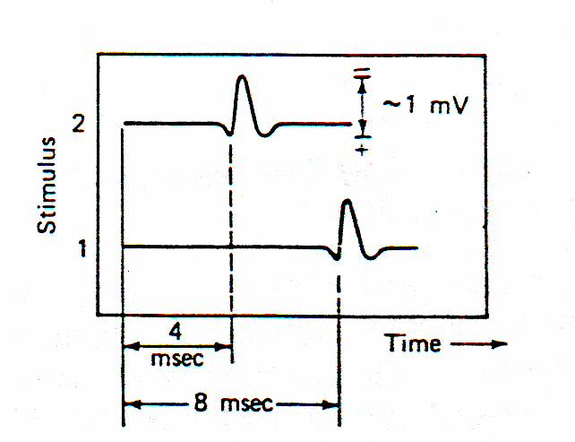
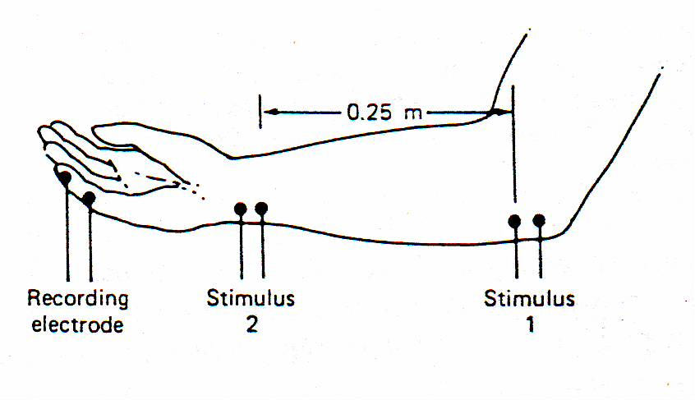
Method of measuring the motor nerve conduction velocity
/25

Slide 25
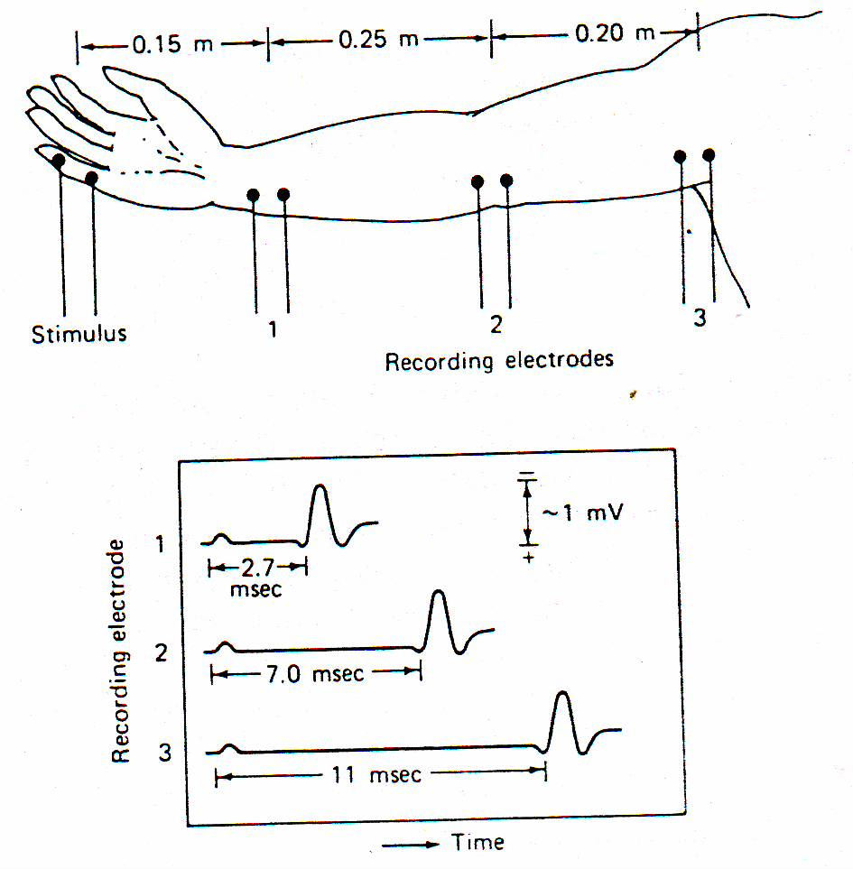
The sensory nerve conduction velocity can be determined by stimulating at one location and recording the responses with electrodes placed at known distances.
/25

